Slide 1
Multiple Linear Regression

Slide 2

Multiple Linear Regression…
Simple Linear Regression
Multiple Linear Regression
Regression Technique

Slide 3

Multiple Linear Regression…
Simple Linear Regression
Multiple Linear Regression
Regression Technique

Slide 4
Multiple Linear Regression…
Simple Linear Regression
Dependent Variable
Multiple Linear Regression
Regression Technique

Slide 5
Multiple Linear Regression…
Simple Linear Regression
Dependent Variable
Independent Variable
Multiple Linear Regression
Regression Technique

Slide 6
Multiple Linear Regression…
Simple Linear Regression
Dependent Variable
Independent Variable
Multiple Linear Regression
Constant
Regression Technique

Slide 7
Multiple Linear Regression…
Simple Linear Regression
Dependent Variable
Independent Variable
Multiple Linear Regression
Constant
Coefficient
Regression Technique

Slide 8
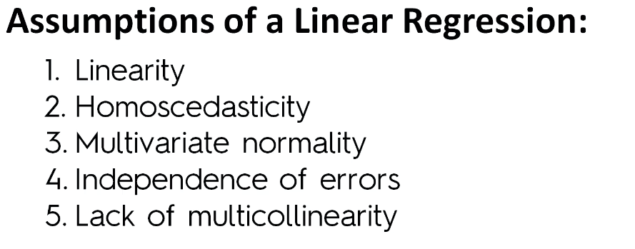
Multiple Linear Regression
Regression Technique

Slide 9
Multiple Linear Regression - Assumption
Linearity
Homoscedasticity
Lack of Multicollinearity
No auto-correlations of residuals
Residuals should be normally distributed
Regression Technique

Slide 10
Multiple Linear Regression - Assumption
Linearity
The relationship between the independent variables and dependent variables need to be linear.
Regression Technique

Slide 11
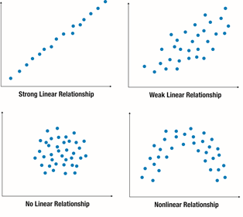
Multiple Linear Regression - Assumption
Linearity
The relationship between the independent variables and dependent variables need to be linear.
The linearity can be tested by using scatter plot:
Regression Technique

Slide 12
Multiple Linear Regression - Assumption
Linearity
The relationship between the independent variables and dependent variables need to be linear.
The linearity can be tested by using scatter plot:
Regression Technique

Slide 13
Multiple Linear Regression - Assumption
Linearity
The relationship between the independent variables and dependent variables need to be linear.
The linearity can be tested by using scatter plot:
Regression Technique

Slide 14
Multiple Linear Regression - Assumption
Linearity
The relationship between the independent variables and dependent variables need to be linear.
The linearity can be tested by using scatter plot:
Regression Technique

Slide 15
Multiple Linear Regression - Assumption
Linearity
The relationship between the independent variables and dependent variables need to be linear.
The linearity can be tested by using scatter plot:
Regression Technique

Slide 16
Multiple Linear Regression - Assumption
Homoscedasticity
Residuals should be constant or equal variance i.e. Homoscedasticity.
If the variance is not constant across the error terms, then there is a case of heteroscedasticity. These non-constant variance across the error terms are due to the presence of outliers in the original data. These outliers influence the model to a huge extent.
Regression Technique

Slide 17
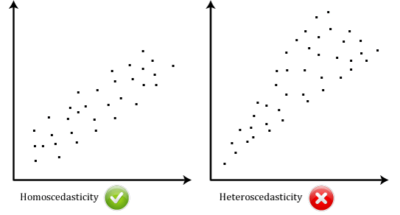
Multiple Linear Regression - Assumption
Homoscedasticity
Residuals should be constant or equal variance i.e. Homoscedasticity.
If the variance is not constant across the error terms, then there is a case of heteroscedasticity. These non-constant variance across the error terms are due to the presence of outliers in the original data. These outliers influence the model to a huge extent.
Simple scatter plot of the residuals can highlight the presence of heteroscedasticity.
NOTE: There is no funnel shape distribution in the plot, this means, signs of homoscedasticity.

Slide 18
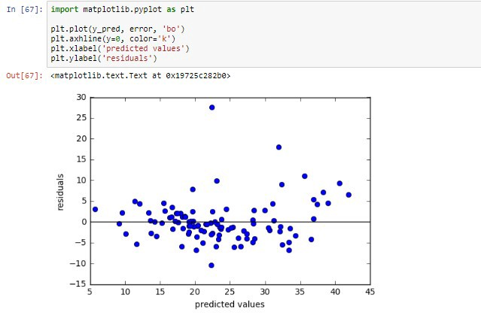
Multiple Linear Regression - Assumption
Homoscedasticity
Residuals should be constant or equal variance i.e. Homoscedasticity.
Other Test Homoscedasticity : GoldFeld-Quandt Test

Slide 19
Multiple Linear Regression - Assumption
No Multi-collinearity in independent variable
There should not be perfect linear relationship between the independent variables.
In other words, there should be no or little multi-collinearity between the independent variables.
We should always look for ways where we can minimize the linear relationship between the independent variables.
Regression Technique

Slide 20
Multiple Linear Regression - Assumption
No Multi-collinearity in independent variable
There should not be perfect linear relationship between the independent variables.
In other words, there should be no or little multi-collinearity between the independent variables.
We should always look for ways where we can minimize the linear relationship between the independent variables.
Following are the ways to determine:
Regression Technique

Slide 21
Multiple Linear Regression - Assumption
No Multi-collinearity in independent variable
There should not be perfect linear relationship between the independent variables.
In other words, there should be no or little multi-collinearity between the independent variables.
We should always look for ways where we can minimize the linear relationship between the independent variables.
Following are the ways to determine:
Scatter plot between the independent variables
Regression Technique

Slide 22
Multiple Linear Regression - Assumption
No Multi-collinearity in independent variable
There should not be perfect linear relationship between the independent variables.
In other words, there should be no or little multi-collinearity between the independent variables.
We should always look for ways where we can minimize the linear relationship between the independent variables.
Following are the ways to determine:
Scatter plot between the variables
Correlation matrix
Regression Technique

Slide 23
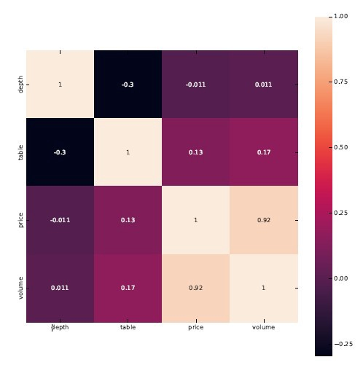
Multiple Linear Regression - Assumption
No Multi-collinearity in independent variable
There should not be perfect linear relationship between the independent variables.
In other words, there should be no or little multi-collinearity between the independent variables.
We should always look for ways where we can minimize the linear relationship between the independent variables.
Following are the ways to determine:
Scatter plot between the independent variables
Correlation matrix
Regression Technique

Slide 24
Multiple Linear Regression - Assumption
No Multi-collinearity in independent variable
There should not be perfect linear relationship between the independent variables.
In other words, there should be no or little multi-collinearity between the independent variables.
We should always look for ways where we can minimize the linear relationship between the independent variables.
Following are the ways to determine:
Scatter plot between the variables
Correlation matrix
Tolerance : Influence of 1 independent variable over the other.
Regression Technique

Slide 25
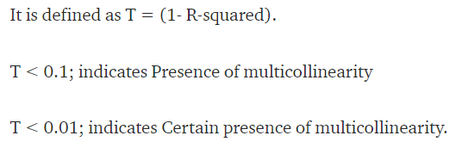
Multiple Linear Regression - Assumption
No Multi-collinearity in independent variable
There should not be perfect linear relationship between the independent variables.
In other words, there should be no or little multi-collinearity between the independent variables.
We should always look for ways where we can minimize the linear relationship between the independent variables.
Following are the ways to determine:
Scatter plot between the variables
Correlation matrix
Tolerance : Influence of 1 independent variable over the other.
Regression Technique

Slide 26
Multiple Linear Regression - Assumption
No Multi-collinearity in independent variable
There should not be perfect linear relationship between the independent variables.
In other words, there should be no or little multi-collinearity between the independent variables.
We should always look for ways where we can minimize the linear relationship between the independent variables.
Following are the ways to determine:
Scatter plot between the variables
Correlation matrix
Tolerance
Variance Inflation Factor (VIF) - VIF is the ratio of variance in a model with multiple terms, divided by the variance of a model with one term alone
Regression Technique

Slide 27
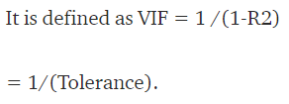
Multiple Linear Regression - Assumption
No Multi-collinearity in independent variable
There should not be perfect linear relationship between the independent variables.
In other words, there should be no or little multi-collinearity between the independent variables.
We should always look for ways where we can minimize the linear relationship between the independent variables.
Following are the ways to determine:
Scatter plot between the variables
Correlation matrix
Tolerance
Variance Inflation Factor (VIF) - VIF is the ratio of variance in a model with multiple terms, divided by the variance of a model with one term alone
Regression Technique

Slide 28
Multiple Linear Regression - Assumption
No auto correlations of residuals
Linear Regression requires that the residuals are have very little or no auto-correlation in the data.
Auto-correlation happens when the residuals are not independent of each other.
Error(i+1) term is not independent of Error(i) term. In other words, the current residual value is dependent on the previous residual value.
Presence of auto-correlation drastically reduces the accuracy of the model.
Regression Technique

Slide 29
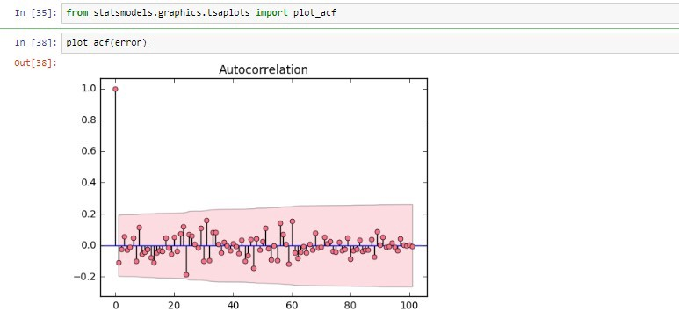
Multiple Linear Regression - Assumption
No auto correlations of residuals
Linear Regression requires that the residuals are have very little or no auto-correlation in the data.
Auto-correlation happens when the residuals are not independent of each other.
Error(i+1) term is not independent of Error(i) term. In other words, the current residual value is dependent on the previous residual value.
Presence of auto-correlation drastically reduces the accuracy of the model.
To check Auto-Correlation using ACF plot:
Regression Technique

Slide 30
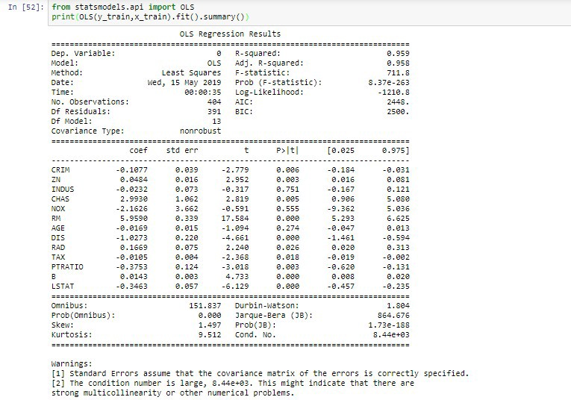
Multiple Linear Regression - Assumption
No auto correlations of residuals
Linear Regression requires that the residuals are have very little or no auto-correlation in the data.
Auto-correlation happens when the residuals are not independent of each other.
Error(i+1) term is not independent of Error(i) term. In other words, the current residual value is dependent on the previous residual value.
Presence of auto-correlation drastically reduces the accuracy of the model.
To check Auto-Correlation using Durbin-Watson test:
Regression Technique

Slide 31
Multiple Linear Regression - Assumption
Residuals should be normally distributed
In a linear regression model, the error terms are normally distributed.
Regression Technique

Slide 32
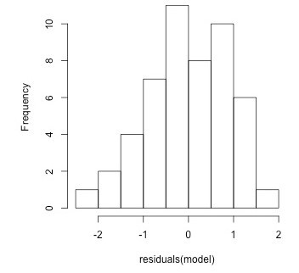
Multiple Linear Regression - Assumption
Residuals should be normally distributed
In a linear regression model, the error terms are normally distributed.
Regression Technique

Slide 33
Multiple Linear Regression - Assumption
Linearity
Homoscedasticity
Lack of Multicollinearity
No auto-correlations of residuals
Residuals should be normally distributed
Regression Technique

Slide 34
Multiple Linear Regression
Dummy Variable
Regression Technique

Slide 35
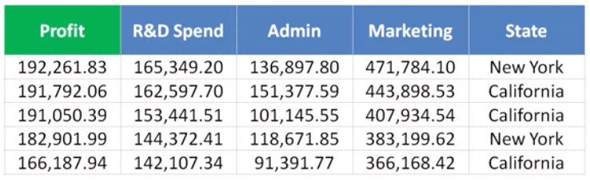

Multiple Linear Regression… - Dummy Variable
Regression Technique

Slide 36
Multiple Linear Regression… - Dummy Variable
Regression Technique

Slide 37
Multiple Linear Regression… - Dummy Variable
Regression Technique

Slide 38
Multiple Linear Regression… - Dummy Variable
Regression Technique

Slide 39
Multiple Linear Regression… - Dummy Variable
Regression Technique

Slide 40
Multiple Linear Regression… - Dummy Variable
Regression Technique

Slide 41
Multiple Linear Regression… - Dummy Variable
Regression Technique

Slide 42
Multiple Linear Regression… - Dummy Variable
Regression Technique

Slide 43

Multiple Linear Regression… - Dummy Variable
Regression Technique

Slide 44
Multiple Linear Regression… - Dummy Variable
Regression Technique

Slide 45

Multiple Linear Regression… - Dummy Variable
Regression Technique

Slide 46
Multiple Linear Regression… - Dummy Variable
1
1
Regression Technique

Slide 47
Multiple Linear Regression… - Dummy Variable
1
0
0
1
0
Regression Technique

Slide 48
Multiple Linear Regression… - Dummy Variable
1
1
1
Regression Technique

Slide 49
Multiple Linear Regression… - Dummy Variable
0
1
1
0
1
Regression Technique

Slide 50
Multiple Linear Regression… - Dummy Variable
1
0
0
1
0
0
1
1
0
1
Regression Technique

Slide 51

Multiple Linear Regression… - Dummy Variable
1
0
0
1
0
0
1
1
0
1
Regression Technique

Slide 52
Multiple Linear Regression… - Dummy Variable
1
0
0
1
0
0
1
1
0
1
NOTE : Dummy Variable works as a Switch – presence of 1 is absence of other

Slide 53
Multiple Linear Regression
Dummy Variable TRAP
Regression Technique

Slide 54

Multiple Linear Regression… - Dummy Variable Trap
1
0
0
1
0
0
1
1
0
1
NOTE : Dummy Variable works as a Switch – presence of 1 is absence of other

Slide 55
Multiple Linear Regression… - Dummy Variable Trap
1
0
0
1
0
0
1
1
0
1
NOTE : Dummy Variable works as a Switch – presence of 1 is absence of other

Slide 56
Multiple Linear Regression… - Dummy Variable Trap
1
0
0
1
0
0
1
1
0
1
NOTE : Dummy Variable works as a Switch – presence of 1 is absence of other

Slide 57
Multiple Linear Regression… - Dummy Variable Trap
1
0
0
1
0
0
1
1
0
1
What can we think of Dummy Variable D1 and D2 ?
NOTE : Dummy Variable works as a Switch – presence of 1 is absence of other

Slide 58
Multiple Linear Regression… - Dummy Variable Trap
1
0
0
1
0
0
1
1
0
1
D1 = 1 – D2
NOTE : Dummy Variable works as a Switch – presence of 1 is absence of other

Slide 59
Multiple Linear Regression… - Dummy Variable Trap
1
0
0
1
0
0
1
1
0
1
D1 = 1 – D2
D2 = 1 – D1
NOTE : Dummy Variable works as a Switch – presence of 1 is absence of other

Slide 60

Multiple Linear Regression… - Dummy Variable Trap
1
0
0
1
0
0
1
1
0
1
NOTE : Dummy Variable works as a Switch – presence of 1 is absence of other

Slide 61
Multiple Linear Regression
P-Value ~ 0.05
Regression Technique

Slide 62
Multiple Linear Regression…
Hypothesis:
Null Hypothesis – Independent Var1 is contributing towards the prediction
Alternate Hypotheses - Independent Var1 is not contributing towards the prediction
Equation – Linear Equation y = b0 + b1 X1 + b2X2 …… + bN XN
Probability of each independent variable getting used in Linear Equation
Test - When my probabillity value i.e. p-value < 0.05 I will reject the null hypotheses
Regression Technique

